Slide 2
Agenda
  Web Services with PHP5
  Extended Reflection API and Annotations for PHP
  WSDL Generator and Adapter Generator
  SOAP Handler Chains and WS-Security for PHP5
  RESTful Web Services
  Administration Frontend and Policy PlugIn
  Live Demo
Notes:
Die Gliederung noch überarbeiten
Einzelteile vielleicht unter Web Service Toolkit für PHP5 zusammenfassen

Slide 3
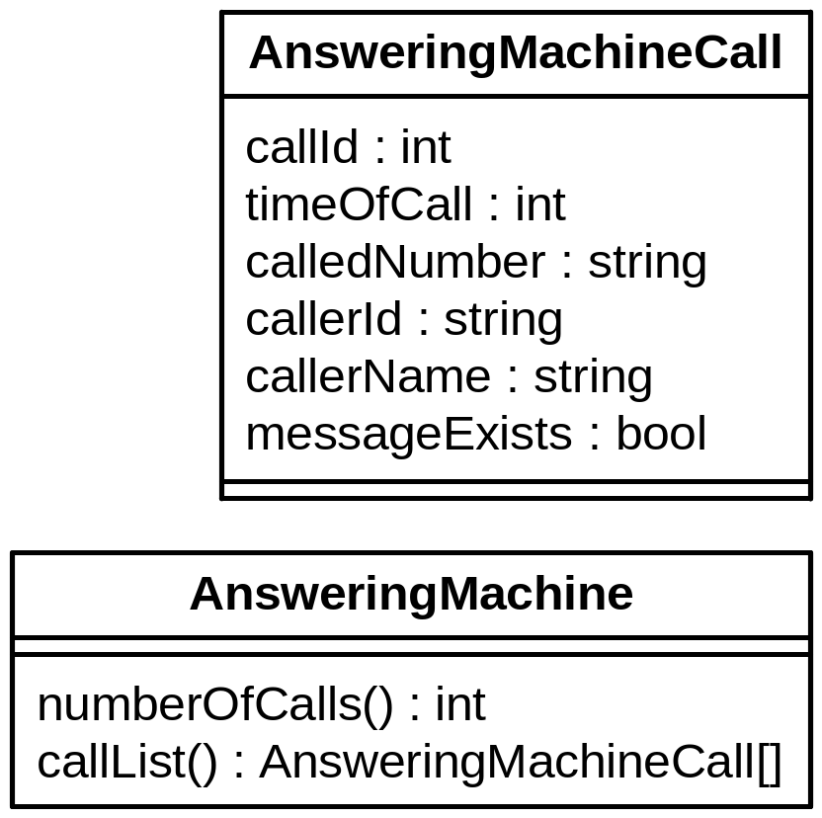
Runing Example
  Application: Answering Machine
    Number of Calls
    List of Calls
  Example Web Service
    using SOAP Protocol
Notes:
Wichtige Punkt für solch einen Web Service
Gesichert durch Authentifizierung
Hier einfaches user/passwort
Je nach scenario vielleciht auch über client-zertifikate usw.
Notwendig einerseits für zugriffskontrolle
Andererseits fürs Abbrechnen der Zugriffe/Billing

Slide 4
Current Situation
Creating Web Services without Tool Support:
  Create XML Schema for Data Types
  Write WSDL Description
  Own Wrapping for Document/Literal
  Include Documentation
  Build SOAP Server Script
  No WS-Security Support

Slide 5
Reflection API
  PHP 5.1 Extension
  Usage of PHP build-in Parser
  Structural Information at Runtime
    Classes
    Methods
    PHP Extensions
  But only very little Information about Types
    PHP is a dynamically typed Language

Slide 6
Annotations
  Additional Information in the Source Code
  Developed from Source Code Comments like:
    Pre and Post Conditions given in Comments
    Conceptual Properties
  Support in .NET and Java 5 already available
    But not in PHP
  Possible Usage Scenarios
    Marking or Configuring of Classes/Methods…
    Aspect-Oriented Programming
Notes:
Annotations sind mit der Zeit entstanden
Oft im Quelltext, in den Kommentaren angaben zu verschiedensten Dingen abgelegt
Pre- und PostConditions
Eigenschaften wie ist Webservice, liese sich zwar z.B. mit interfaces oder vererbung ebenfalls realisieren, als markierung
Ist teils jedoch nicht gewünscht, da mit konsequenzen verbunden

Slide 7
PHPDoc as Basis for Annotations
  PHPDoc widely used in many Projects for Documentation
  Good Starting Point for Annotations
  Comparable Development in Java with XDoclet
  /**
  * @myAnnotation paramA paramB
  */
  class Lecture {
  /**
  * @return int
  */
  public function getId() { return intval($this->id); }
  /**
  * @param string $value
  */
  public function setName($value) { $this->name = $value; }
  }

Slide 8
Extended Reflection API
  Extending the Reflection API of PHP5.1
    Implemented in PHP
  Adding Annotation Mechanism
  Typing
    Parameters
    Return Values
    Attributes
  Types represented as Objects
  for easy usage
    E.g. generate XMLSchema

Slide 9
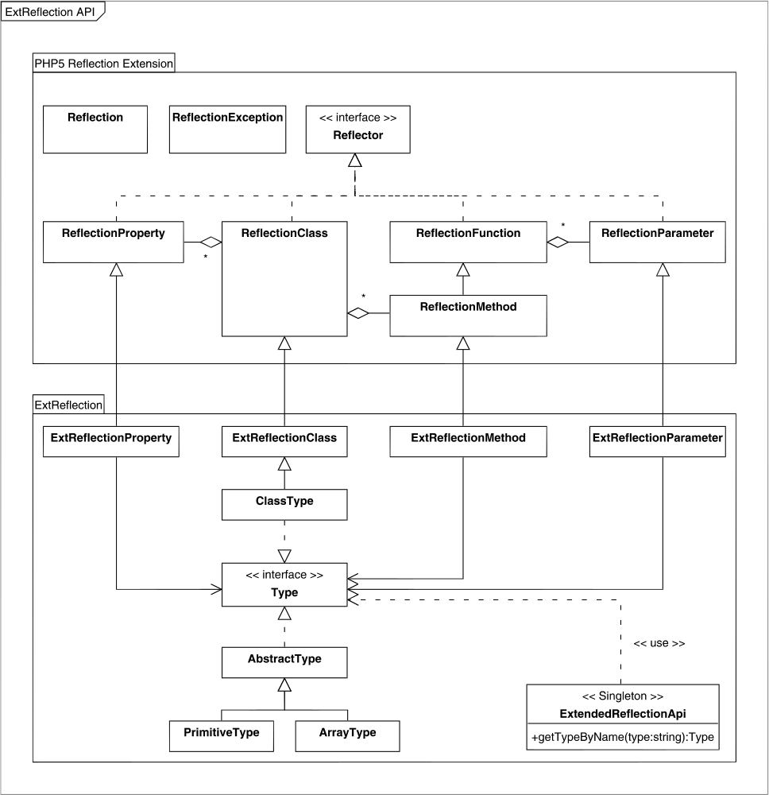
The PHP Extension

Slide 10
Extended Reflection API
  Extended with Annotations and a type system
Notes:
Überleitung
- Aufbauend auf Reflection API

Slide 11
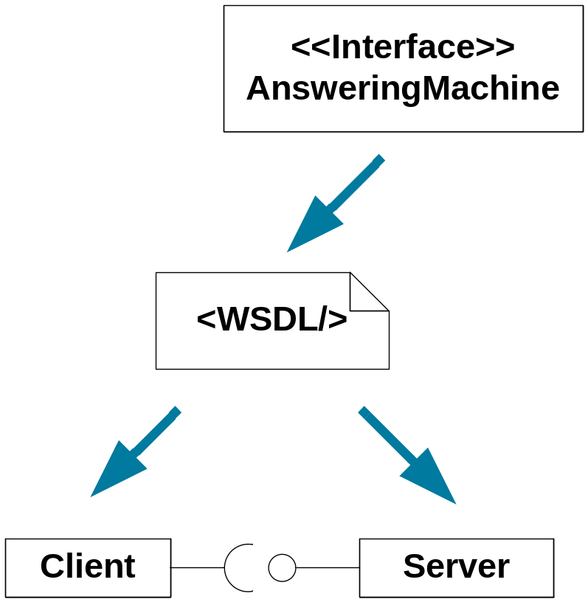
Web Services Description Language (WSDL)
  Platform independent language for describing interfaces
  Description contains
    Interface
    Method signatures
    Data types
  Used with SOAP
  Additional Aspects for usage
  with REST in WSDL 2.0

Slide 12
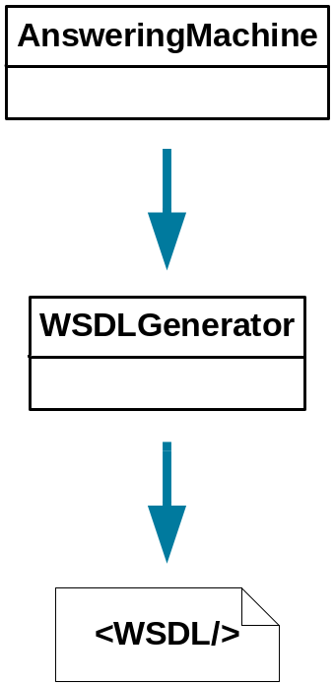
WSDL Generator
  Generates WSDL from PHP Classes or Collections of Functions
  WSDL 1.1
    Conforms to the WS-I Basic Profile by 95%
    Supports RPC Encoded / Literal
    and Document Literal / Wrapped
  Implemented as DOMDocument
  Tested with phpt Test Cases
    Partially used from SOAP Extension
  Adapter Generator
    For document-wrapped Binding
    Classes for Un/wrapping of Arguments and Return Values
Notes:
Adapterklasse realisiert Kapselung
Unwrapping der Argumente
Wrapping der Rückgabewerte

Slide 13
Other Web Service Standards
  Basics are already implemented for PHP
    SOAP: PHP5 Extension, PEAR SOAP, NuSOAP
    UDDI: PEAR-Paket
    WSDL: Generator
  Over 20 possible WS-* Standards for
    Security
    Synchronisation
    Sessioning
  Standards add new Elements to SOAP Header

Slide 14
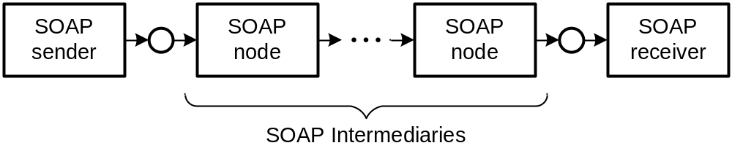
SOAP Intermediaries
  SOAP Standard describes Intermediaries
  Intermediaries are working on SOAP Message before reaching Ultimate Receiver
  Additional Features independent of final Web Service
  Implementation pattern: Handler-Chain

Slide 15
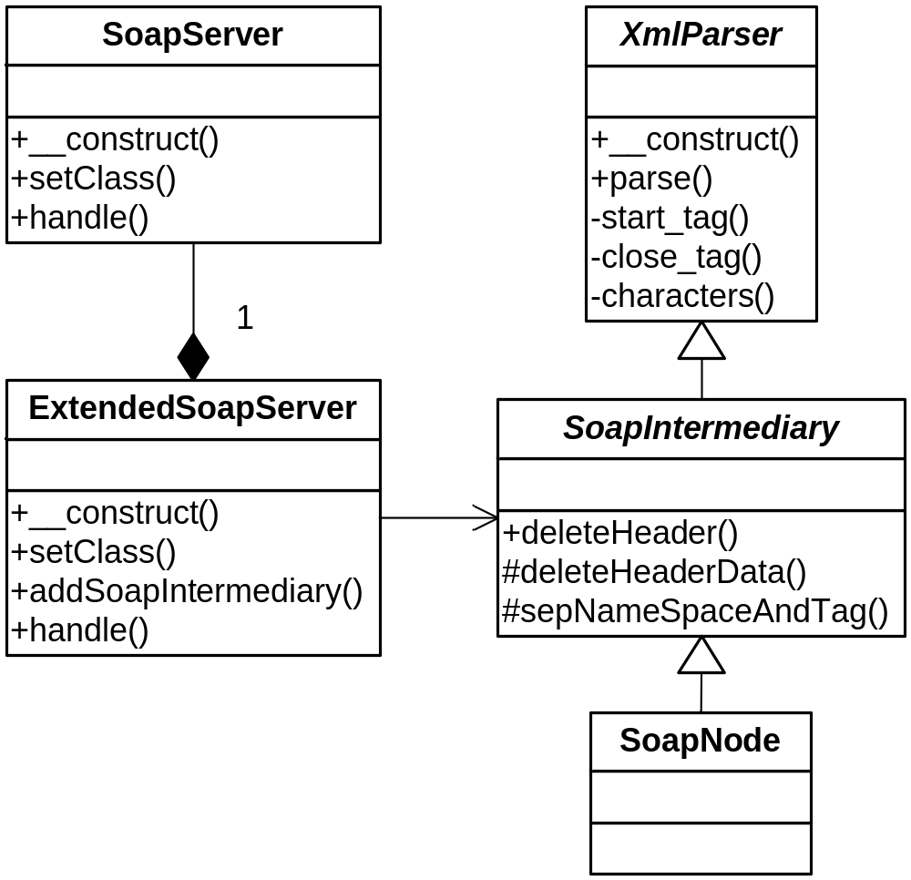
Handler Chain Mechanism

Slide 16
WS-Security for PHP5
  Security Concepts for Web Services:
    Confidentiality => SSL (SOAP via HTTPS)
    Authentication => WS-Security + Token Profiles
    Authorisation => Application
  TODO: Security Components => WS-Security
  WS-Security defines SOAP-Header-Element for
  security-related Data
  Different Profiles specify several Authentication Mechanisms
  First Profile implemented: Username Token Profile 1.0

Slide 17
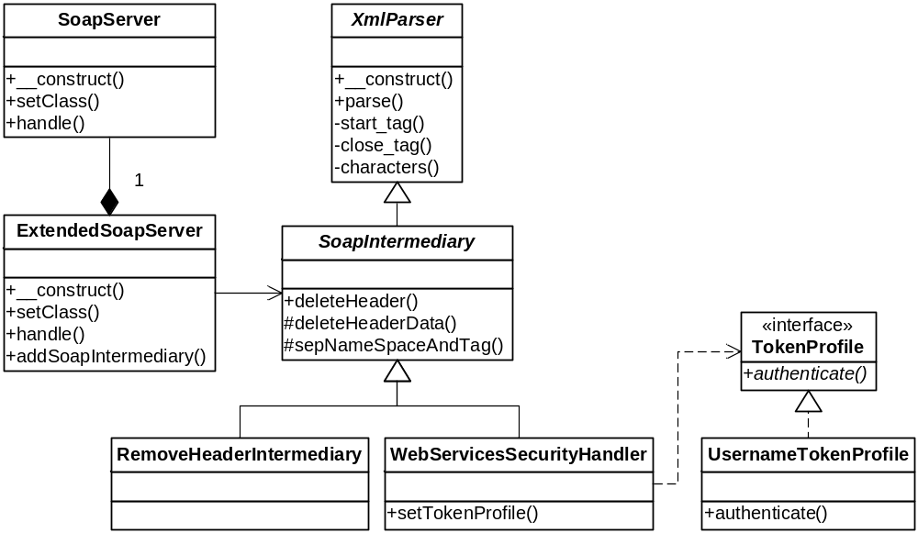
Username Token Profile 1.0 (Server)

Slide 18
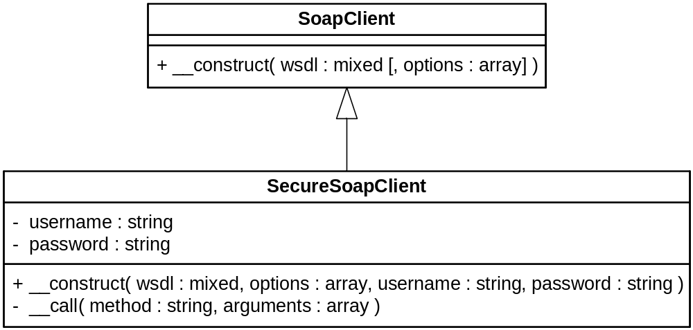
Username Token Profile 1.0 (Client)

Slide 19
Representational State Transfer (REST)
  Alternative to SOAP Web Services
  Resource-oriented Approach
  HTTP-REST
    Just uses HTTP Methods
      GET, POST, PUT, DELETE
    Messages with Payload Semantic instead of RPC Semantic
  Implemented using a Remote Facade
    Mapping from URIs to PHP methods
    Custom De/Serialiser for PHP Objects
    REST Server Configuration generated from Code Annotations
  Security by TLS or DigestAuth (RFC2617)
Notes:
Roy Thomas Fielding
uniforme und minimale Interfaces
Bei SOAP definiert jede Anwendung/Web Service eingenes Interface
Vorteile Interoperabilität
Aussagen über allgemeines Verhalten der Dienste möglich, da uniforme Schnittstelle → uniforme Semantik
Verwendung des allgemeinen HTTP-URI Namensraumes für alle Resourcen

Slide 20
Administration Tool &
Policy Plug-In
  Administration Tool
    Automated Creation of Web Services from existing Applications
    Annotations identify Classes to be used
    Administration via Web Frontend
      Classes and Methods selected by User
      Generates SOAP and REST Server Scripts
      Generates WSDL File and Adapter Classes
      SOAP Server with WS-Security
  Policy Plug-In for WSDL-Generator
    Filters Methods to be hidden from Web Services
    Adds Comments to WSDL Ports from Source Code Documentation
    Enables Administrator to edit published Comments

Slide 21
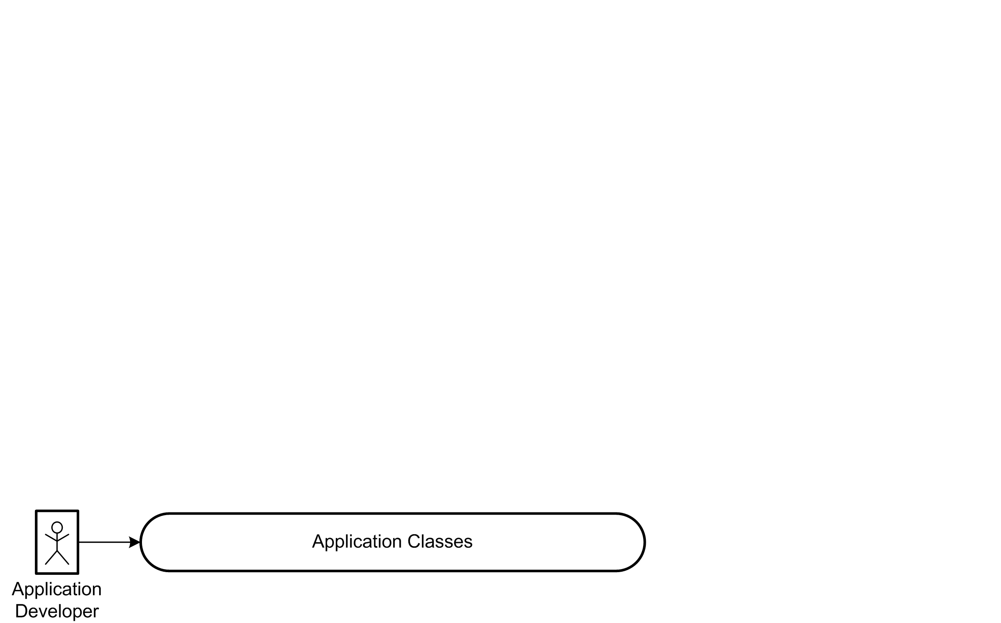
Interaction Overview

Slide 22
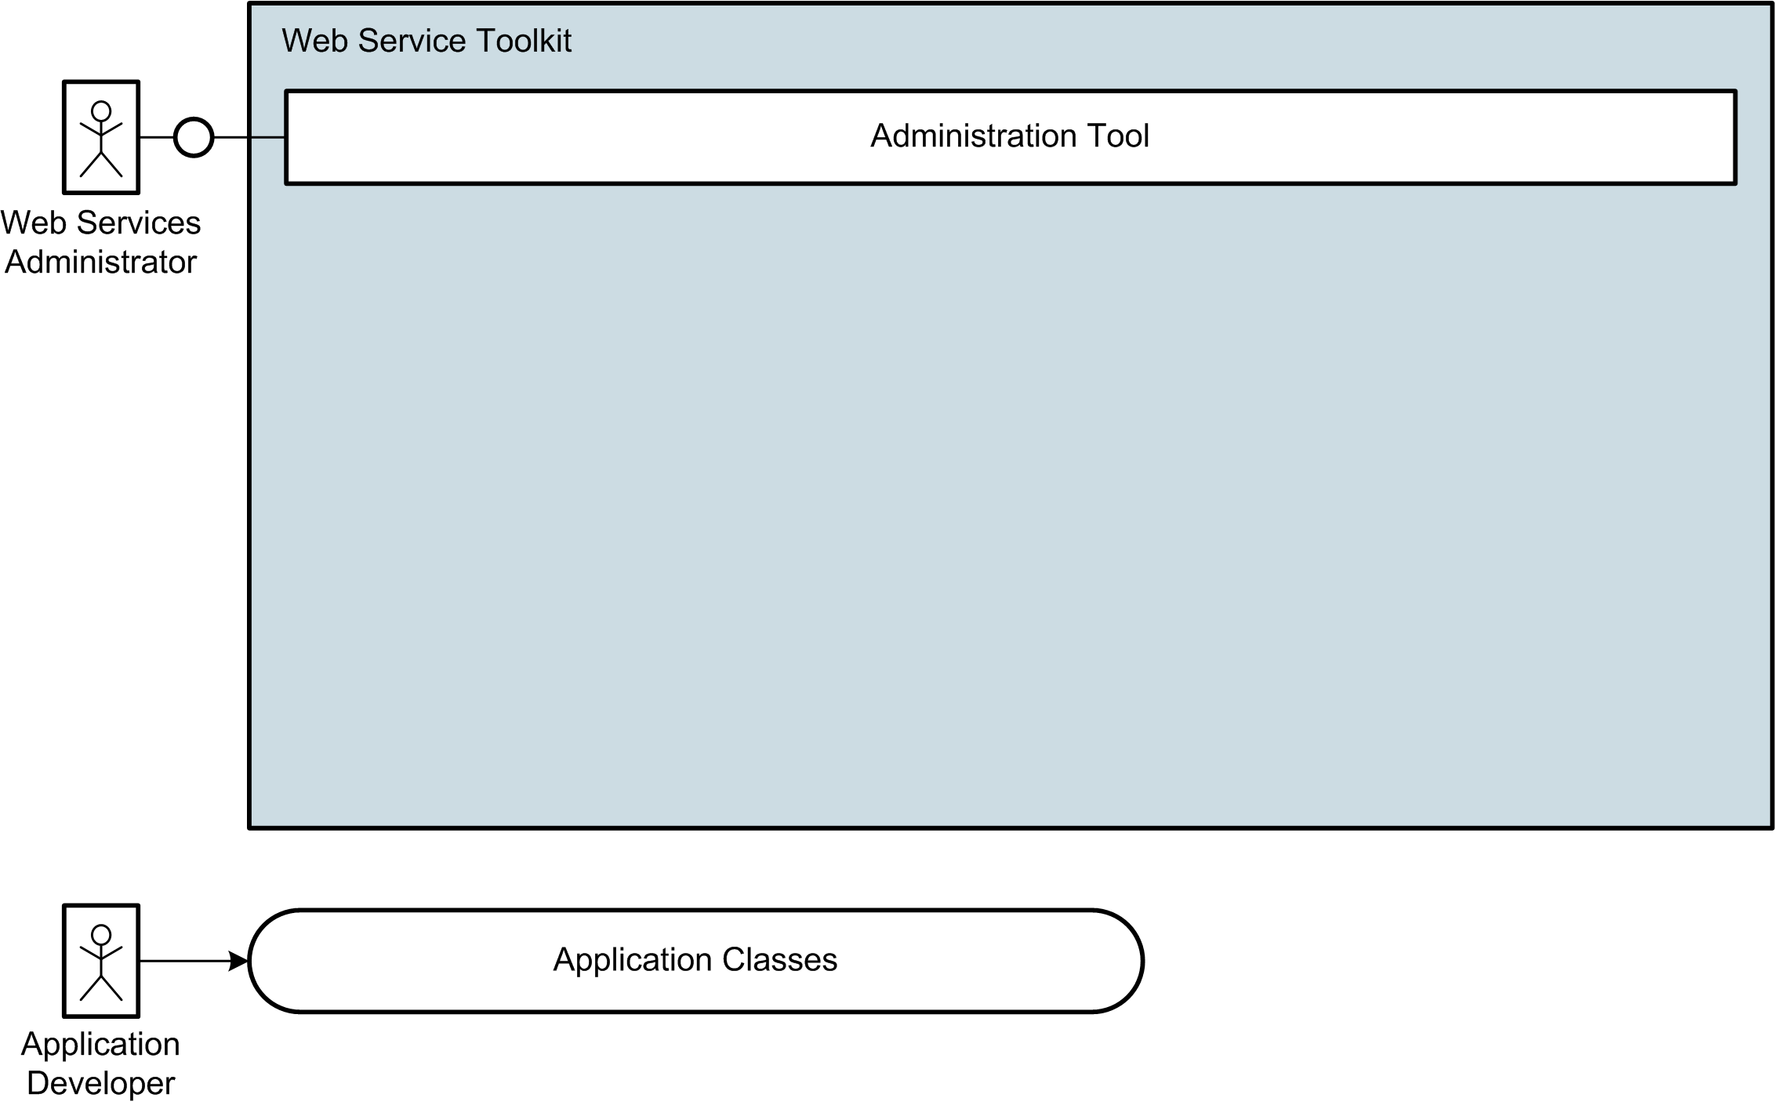
Interaction Overview

Slide 23
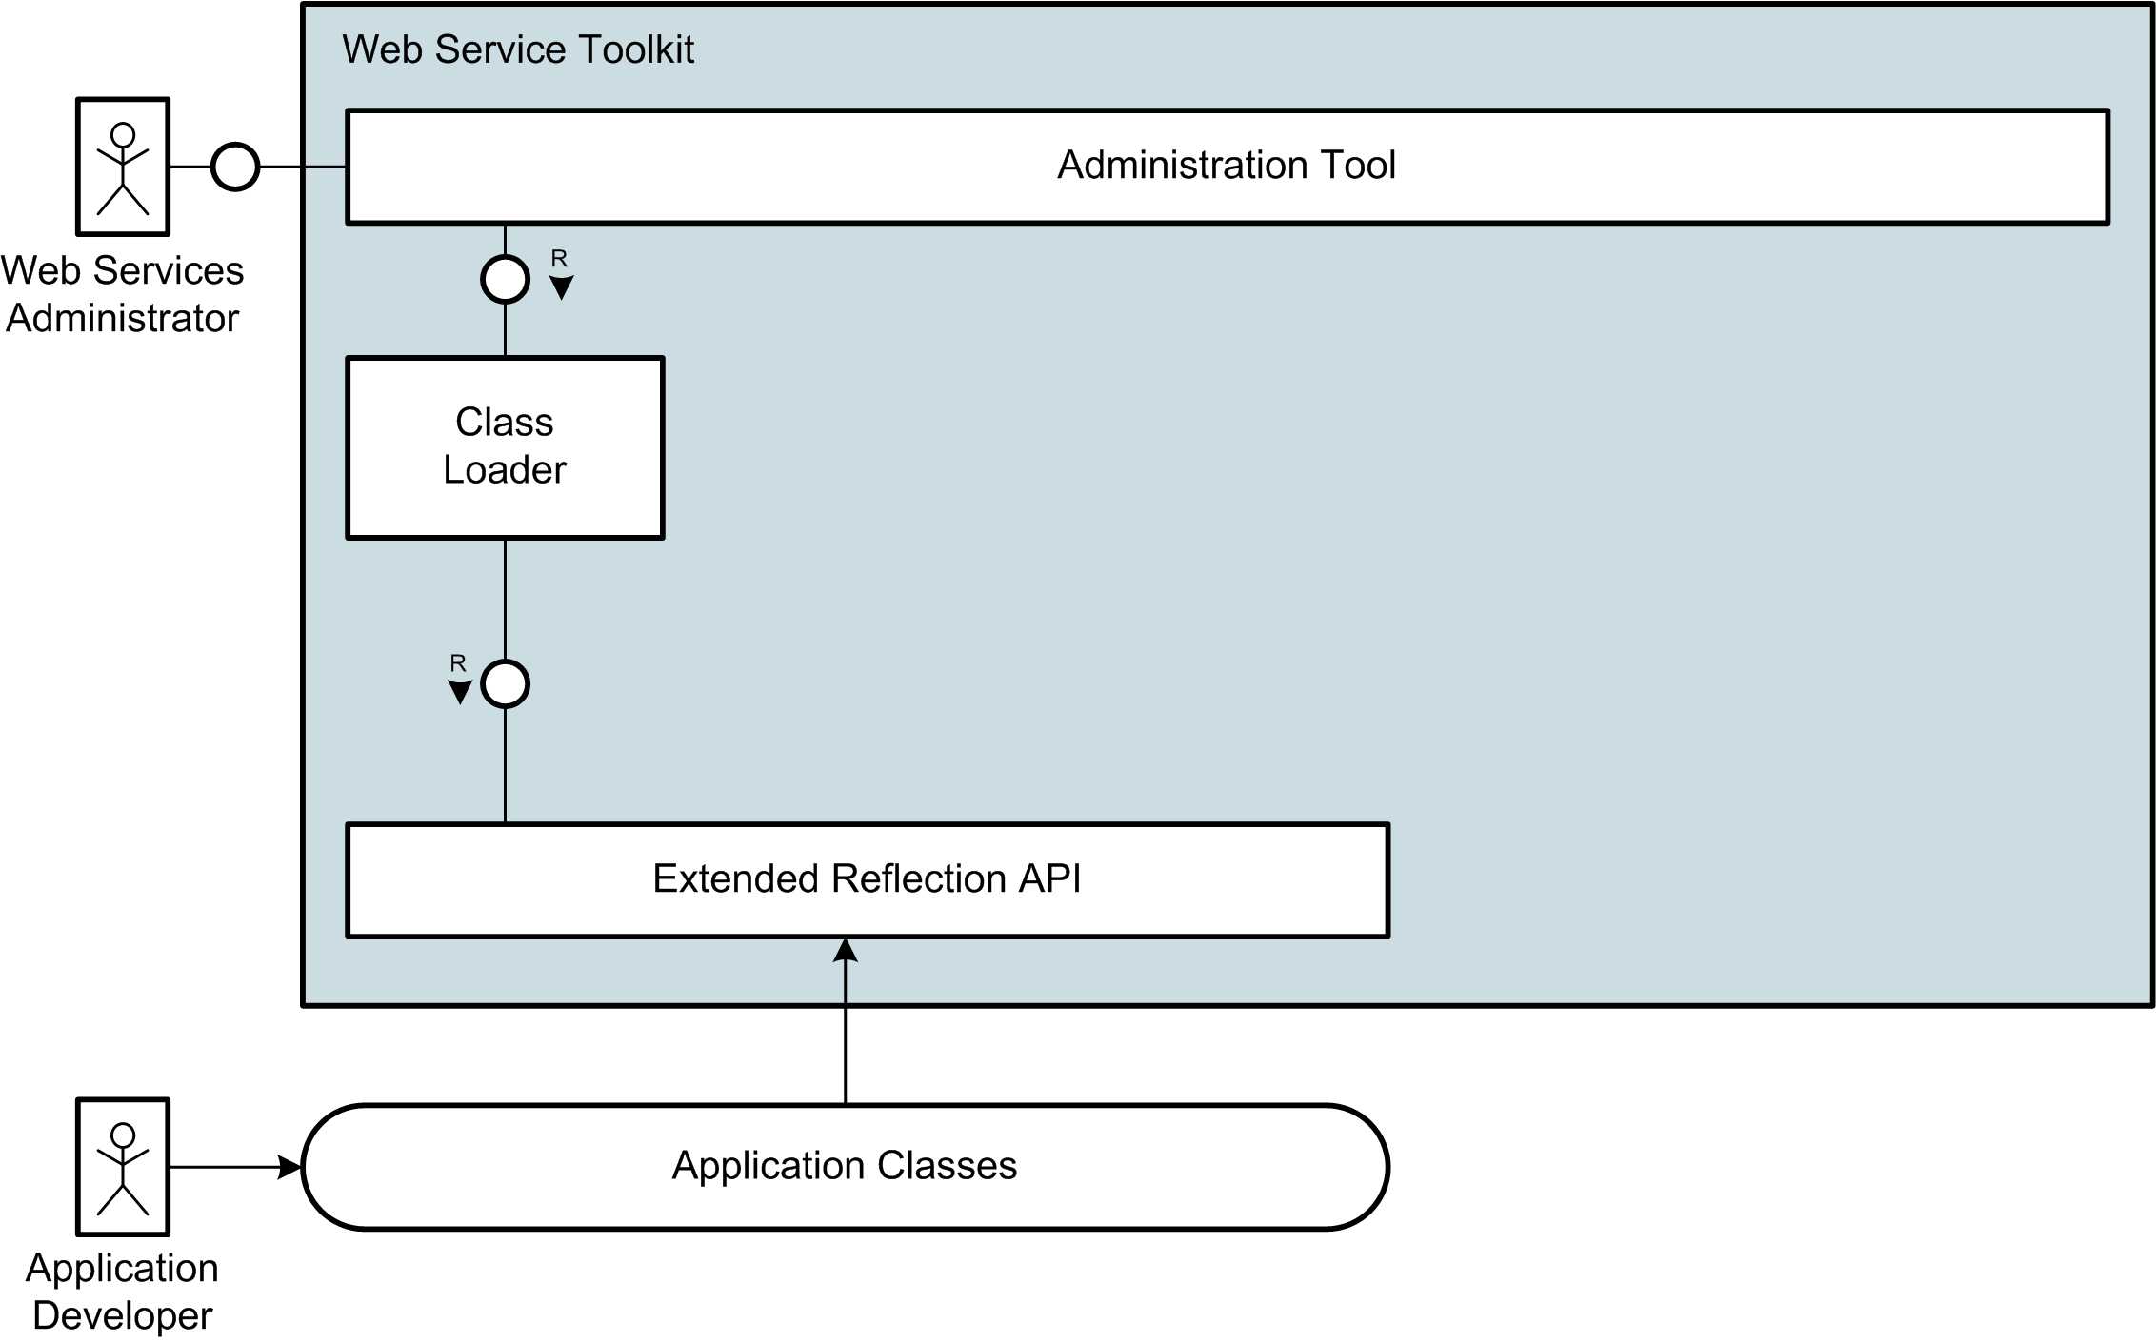
Interaction Overview

Slide 24
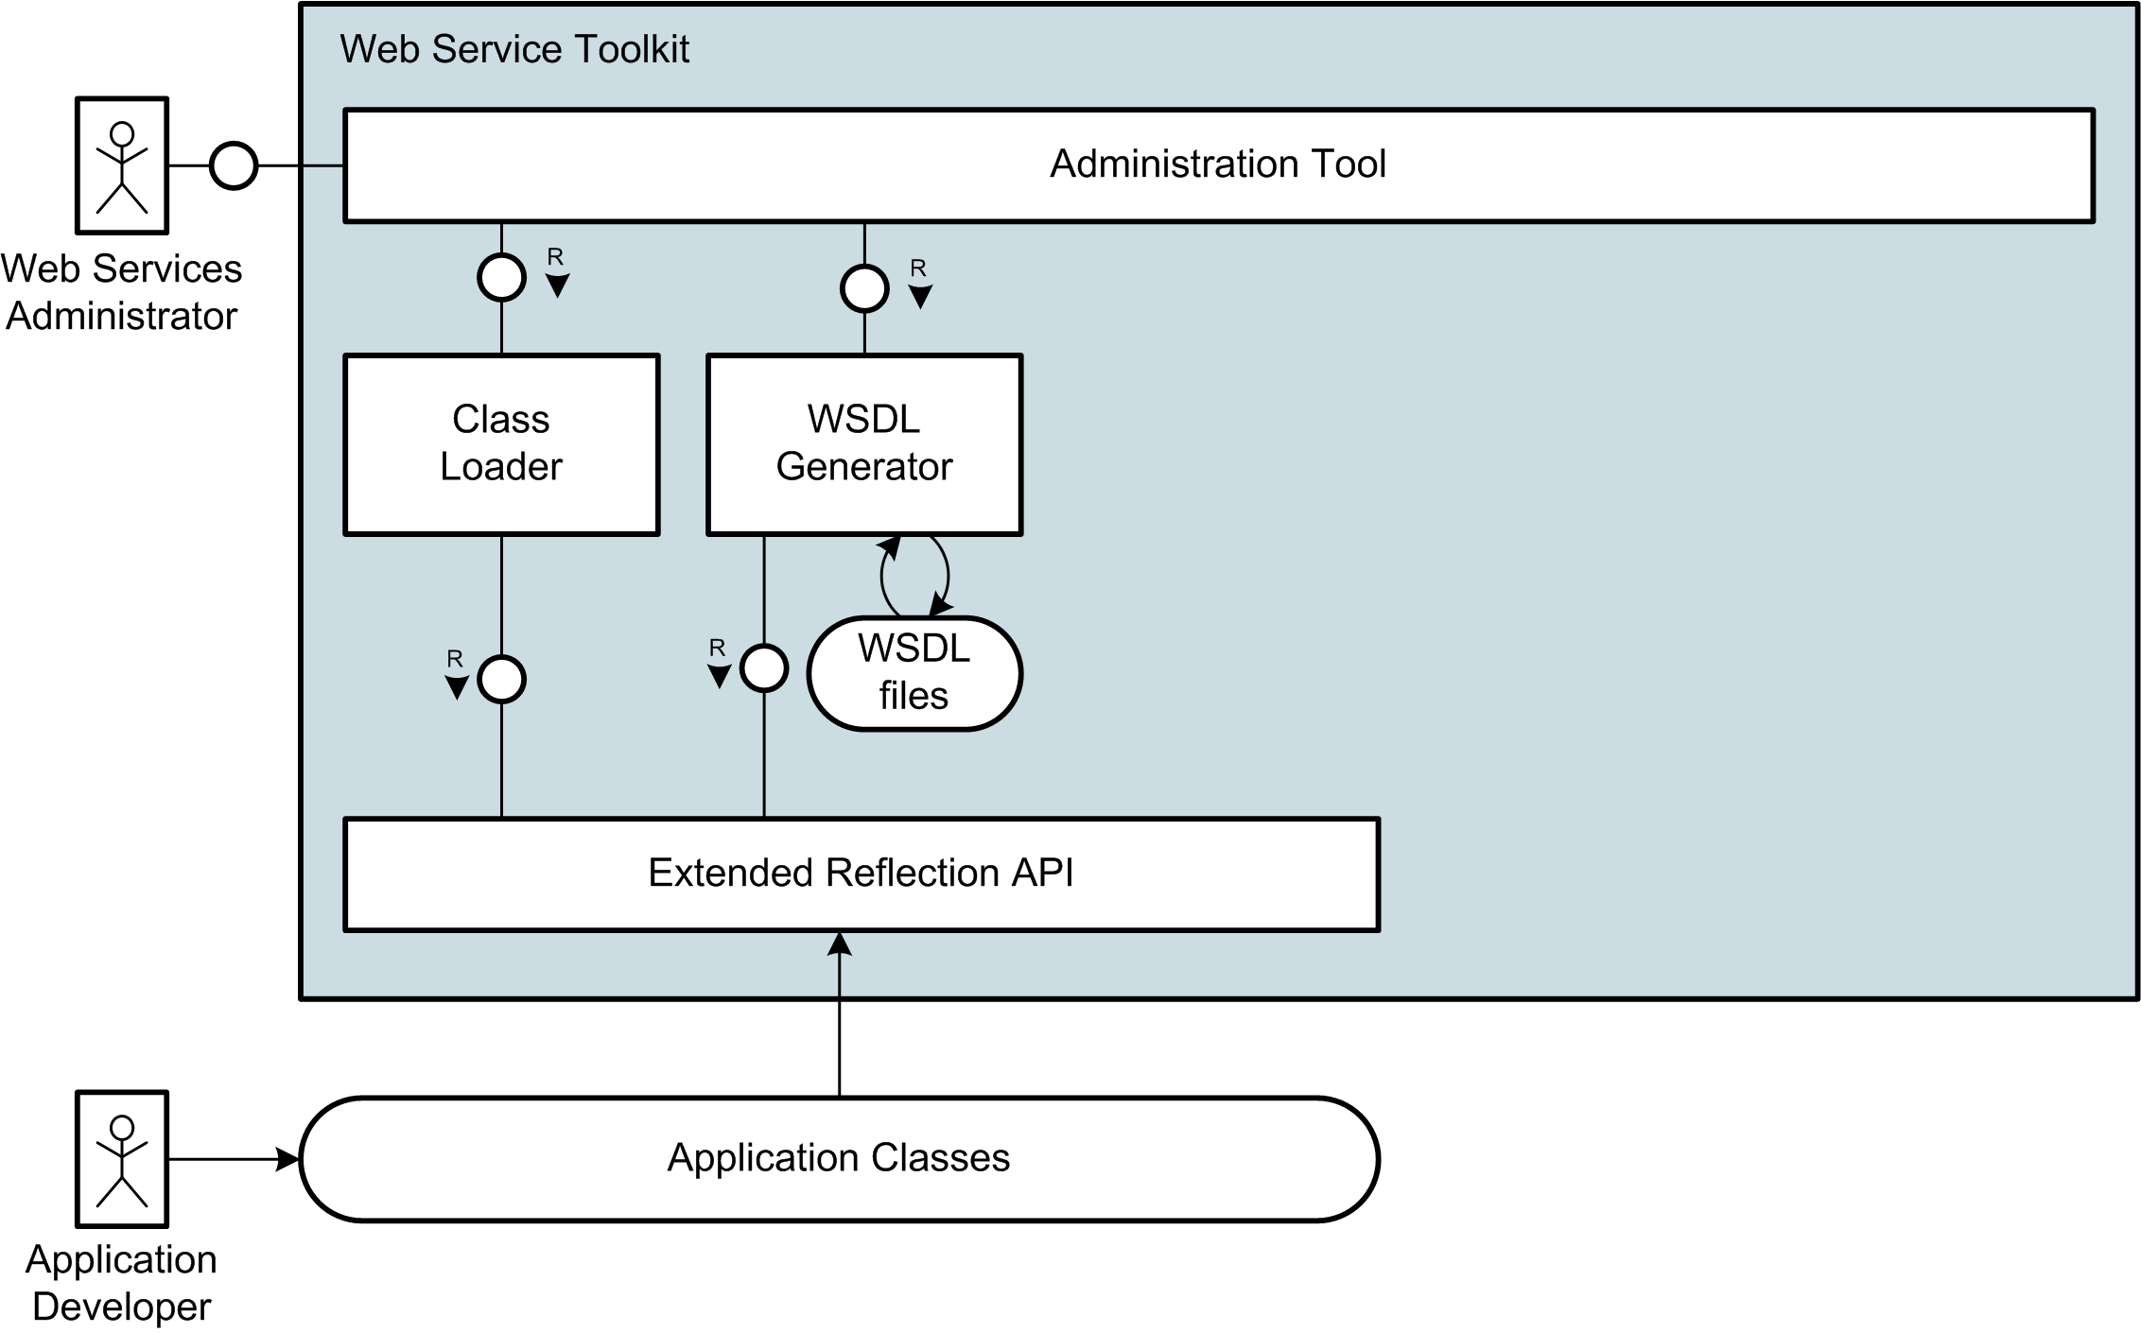
Interaction Overview

Slide 25
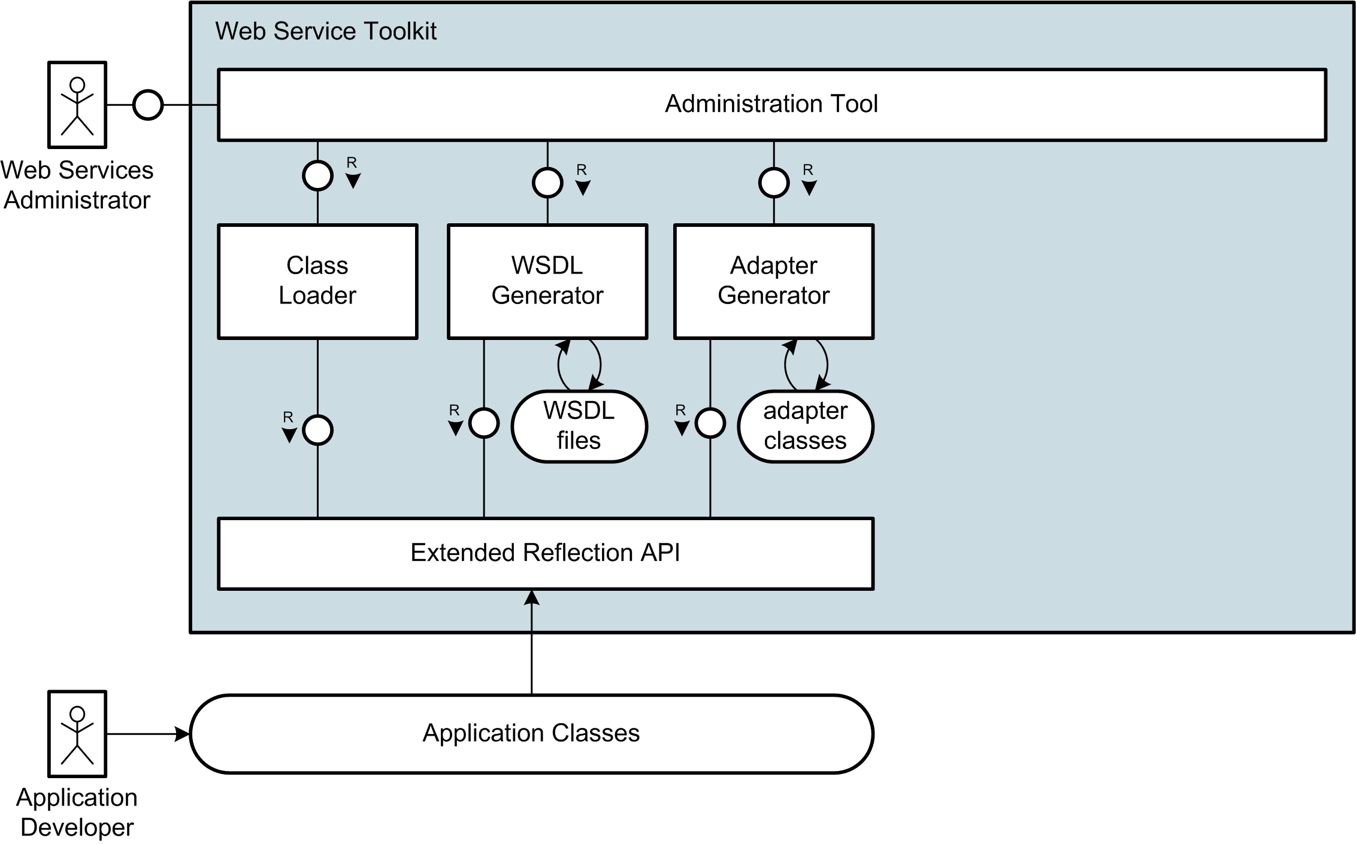
Interaction Overview

Slide 26
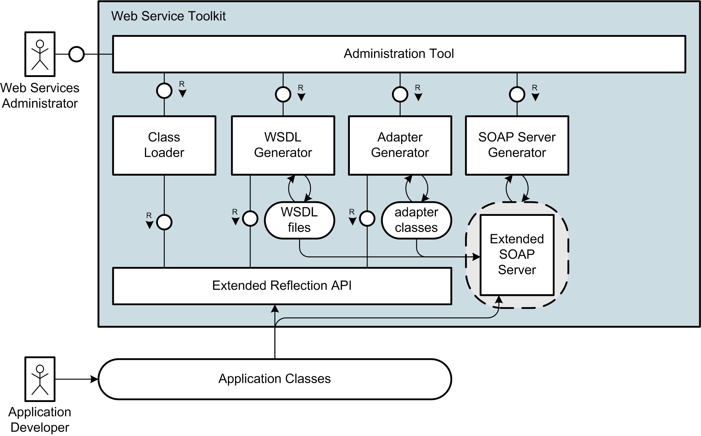
Interaction Overview

Slide 27
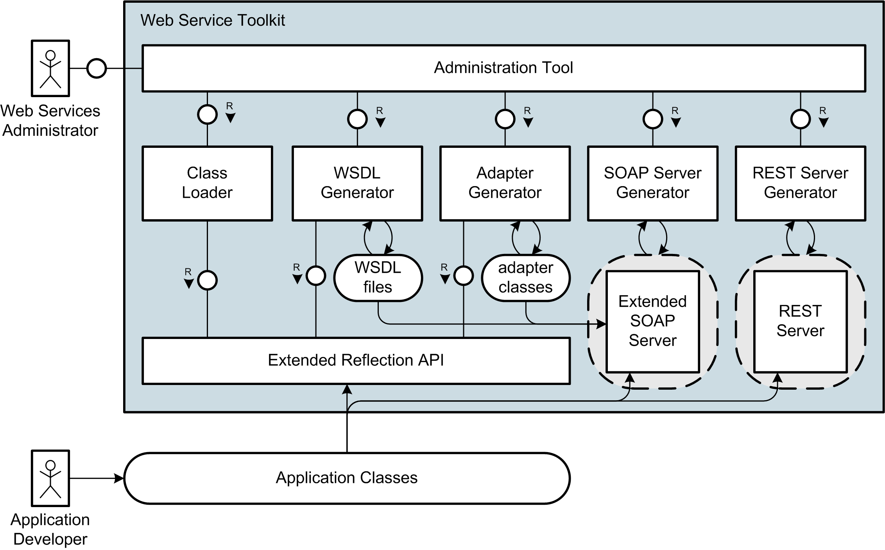
Interaction Overview

Slide 28
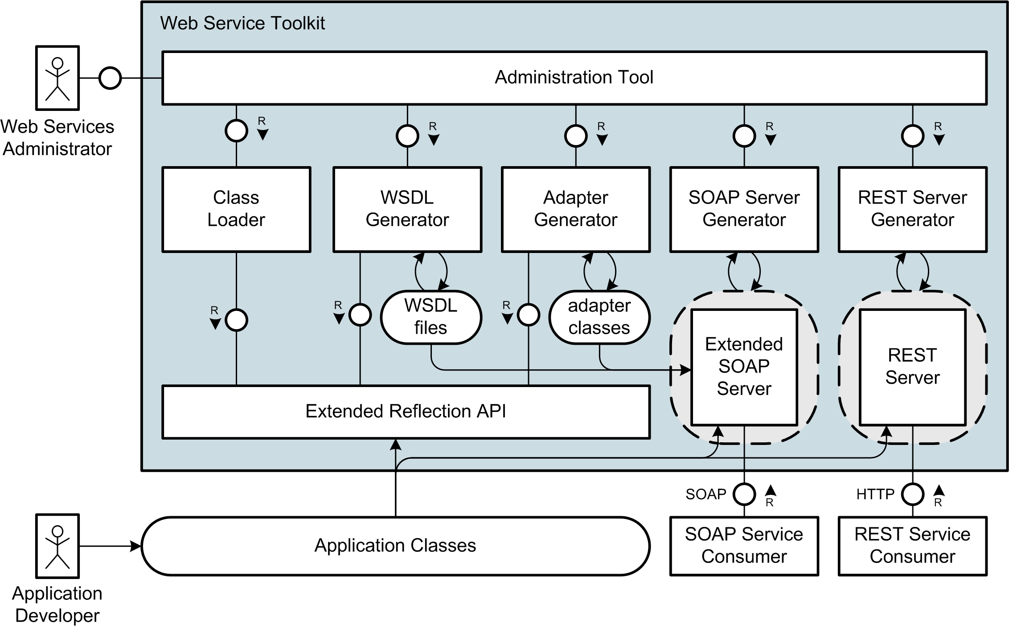
Interaction Overview

Slide 29
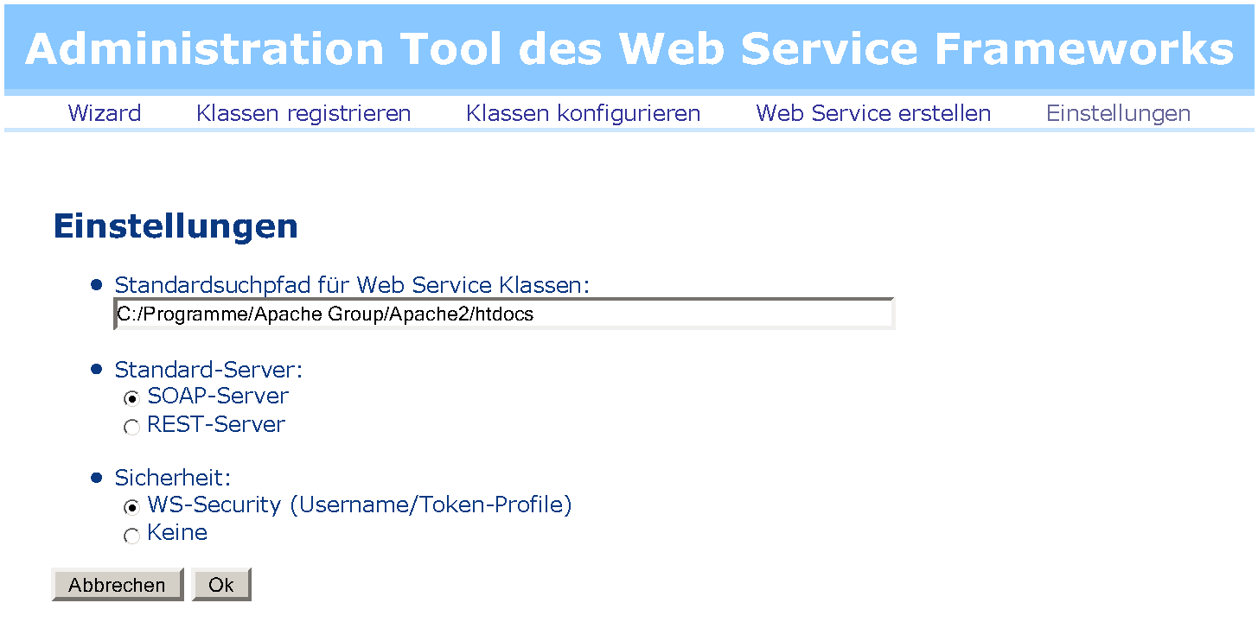
Live Demo

Slide 30
Summary
  Extended Reflection API with Information about Types
  Annotations for PHP
  WSDL Generator conform to WS-I Basic Profile
  Document/Literal Adapter Generator
  Handler Chain Mechanism for SOAP Processing
  Implementation of WS-Security and Username Token Profile
  RESTful Web Services
  Administration Tool for convenient Creation und Management of SOAP and REST Services
Notes:
Die Gliederung noch überarbeiten
Einzelteile vielleicht unter Web Service Toolkit für PHP5 zusammenfassen

Slide 31
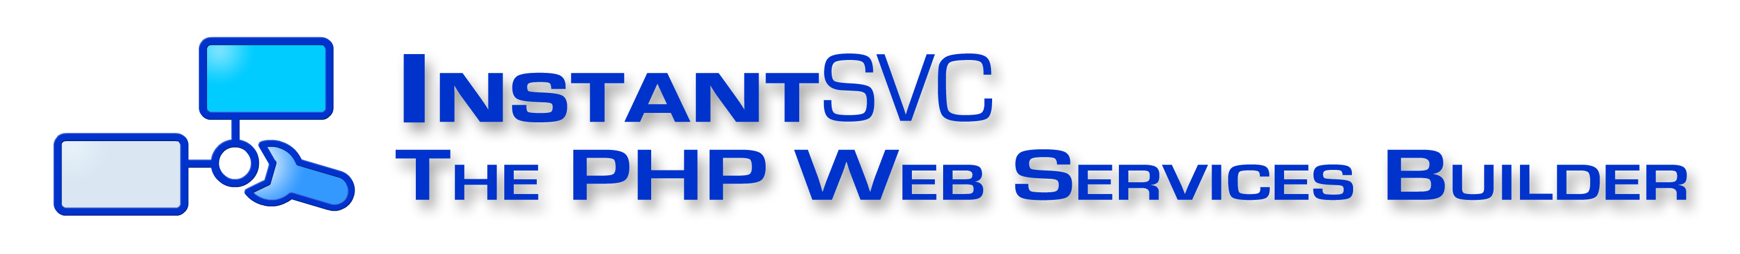
Further Information and Download at:
http://instantsvc.sf.net

Slide 33
The Core Web Services Protocol Stack
Discovery | UDDI (Itself a Web Service)
Description | WSDL, WSFL/XLANG, others to come
Access | SOAP, SOAP with Attachments, XML-RPC, REST
Transfer | HTTP, SMTP, FTP, others
Transport | TCP/IP, UDP, others

Slide 34
Web Services Description Language (WSDL)
A WSDL Document uses the following Elements:
  Types– a container for data type definitions using some type system (such as XSD).
  Message– an abstract, typed definition of the data being communicated.
  Operation– an abstract description of an action supported by the service.
  Port Type– an abstract set of operations supported by one or more endpoints.
  Binding– a concrete protocol and data format specification for a particular port type.
  Port– a single endpoint defined as a combination of a binding and a network address.
  Service– a collection of related endpoints
Source: W3C.org

Slide 35
Document/Literal
Adapter Generator
/**
* @param int $id
* @return Lecture
*/
public function getLecture($id) {…}
public function getLecture($param) {
return array("Lecture“
=> $this->target->getLecture($param->id));
}

Slide 36
WS-Security
Username Token Profile 1.0
<wsse:Security>
<wsse:UsernameToken>
<wsse:Username>Stefan</wsse:Username>
<wsse:Password Type="...#PasswordDigest">
weYI3nXd8LjMNVksCKFV8t3rgHh3Rw==
</wsse:Password>
<wsse:Nonce>WScqanjCEAC4mQoBE07sAQ==</wsse:Nonce>
<wsu:Created>2006-06-24T11:00:00Z</wsu:Created>
</wsse:UsernameToken>
</wsse:Security>

Slide 37
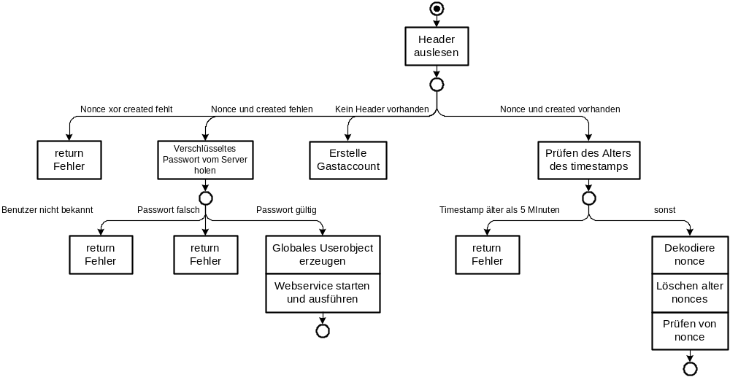
Username Token Profile (1/2)

Slide 38
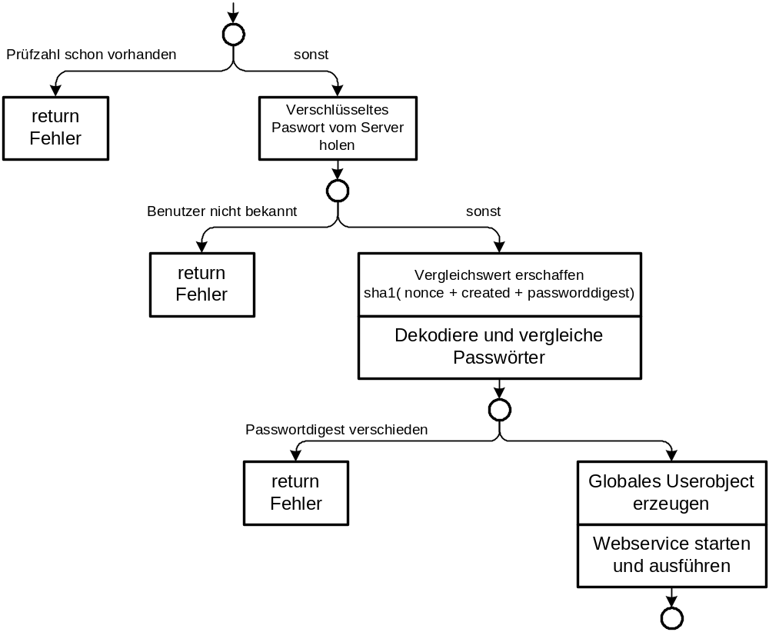
Username Token Profile (2/2)

Slide 39
Suggested Reading
White Papers
[1] Einführung in XML Web Services, October 2005
[2] Web Services Facade for PHP5 – Konzeption, January 2006
[3] Web Service Toolkit für PHP5, March 2006
download at http://instantsvc.sf.net/
Further Sources
[4] RESTful Web Services, January 2006
http://www.stefan-marr.de/artikel/restful-web-services.html
[5] SOAP Version 1.2 specification, W3C Recommendation, June 2003. http://www.w3.org/TR/soap/
[6] Web Services Description Language (WSDL) 1.1, W3C Note, March 2001. http://www.w3.org/TR/wsdl/
[7] Username Token Profile 1.0, OASIS, January 2004
http://docs.oasis-open.org/wss/2004/01/oasis-200401-wss-username-token-profile-1.0.pdf

